Slide 1

Airbnb Price Listing
By
Abiodun Owoeye

Slide 2

The goal of this experiment is to build a model that can predict a competitive price for listings on Airbnb.
This session will cover:
Introduction and Objectives
Data pre-processing, text cleaning, results, hypothesis testing, modelling, and evaluation metrics.
Methods, Experiment, and Outcomes
The summary will explain the position of the analysis and make conclusions.
Summary

Slide 3

Introduction
Goal
The goal of this experiment is to build a pricing model.
The experiment aims to build three algorithms that can predict Airbnb property letting prices.
Key Variables
Host Location,
Property Type
Room Type
Amenities
Super host
Accommodates
Bedrooms
Beds
Minimum Nights
Ratings
Availability
Price (label)
Variables Excluded
Neighborhood Overview
Host Name
Host About
Host Response Time
Host Verifications
Number of Reviews
Neighbourhood

Slide 4

Methods
Data Collection and
Pre-processing
Feature Selection
Hypothesis Testing
Dimensionality Reduction
Data Partitioning
Evaluation Metrics
Modelling
Feature Scaling

Slide 5
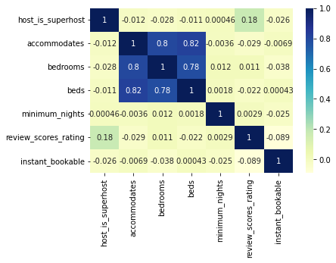
Feature Selection
Cat Var(chi-square)
Numeric Variables(ttest)
Name | P-Value
Host Location, Property Type | 0.0
Host Location, Room Type | 3.00e-70
Host Location, Amenities | 0.0
Property Type, Host Location | 0.0
Property Type, Room Type | 0.0
Property Type, Amenities | 0.0
Room Type, Host Location | 3.00e-70
Room Type, Property Type | 0.0
Room Type, Amenities | 4.439e-23
Amenities, Host Location | 0.0
Amenities, Property Type | 0.0
Amenities, Room Type | 4.439e-23
Name | P-Value | Name | P-Value
Host Is Super Host, Accommodates | 0.0 | Accommodates, Inimum Nights | 0.0
Host Is Super Host, Bedrooms | 0.0 | Accommodates, Review Scores Rating | 0.0
Host Is Super Host, Beds | 0.0 | Accommodates, Instant Bookable | 3.119e-153
Host Is Super Host, Minimum Nights | 0.0 | Bedrooms, Beds | 0.0
Host Is Super Host, Review Scores Rating | 0.0 | Bedrooms, Minimum nights | 0.0
Host Is Super Host, Instant Bookable | 0.0 | Bedrooms, Review Scores Rating | 0.0
…
Categorical Variables
Strong Multicollinearity
A strong relationship between "accommodates", "bedrooms", and "beds“. Base: ≥ 80%

Slide 6
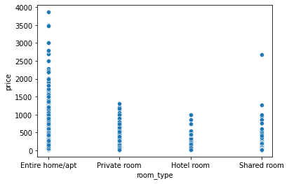
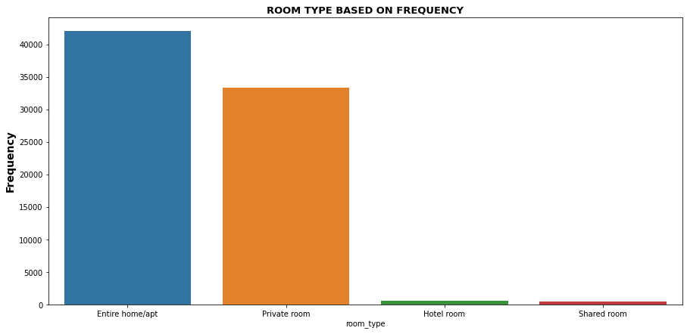
Analysis
Most sought after listing room type
[Entire Home/apt]
[space is key]
Dynamic pricing is advantageous as prices are fairly distributed depending on property size
67% of average price = 105.63
Fairly good distribution of average priced Airbnb for Entire Home
Price not exclusive nor advantageous to minimum nights
Most sought after location
[London] [avg price = 105.63]
Average Airbnb Price is 107.51
Room Type( Price )
Room Type(Frequency)

Slide 7
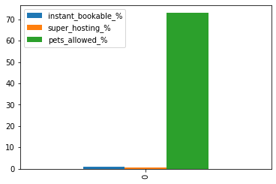
Analysis
Contributions to Price Setting Advantage
Instant Booking | Super Hosting | Pets Allowed
0.75% | 0.48% | 73%
Pets
How does allowing pets contribute to price setting?
0.05% of listings allows pets(41 of 76503)
Instant Booking
How does instant booking contribute to price setting?
Instant booking contributes only 0.75% of price increase over average price.
Super Hosting
How does super hosting contribute to price setting?
Super-host contributes only 0.48% of price increase over average price.
73% of the listings that allows pets set price above average price 107.5.(30 of 41)
Pets Allowed will be advantageous to price setting

Slide 8
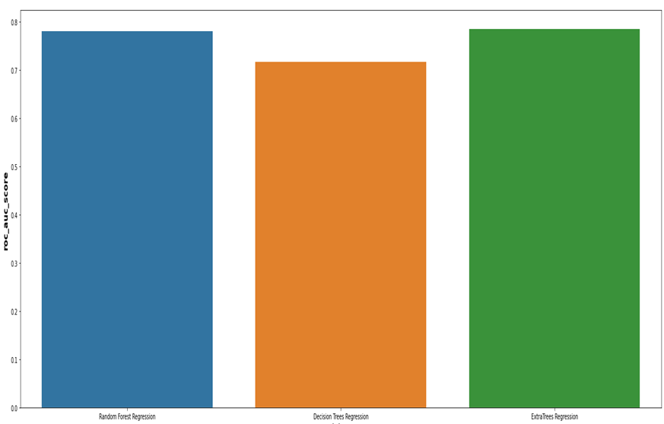
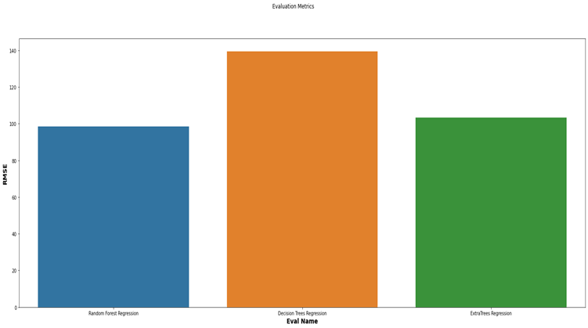
Modelling
and Metrics
Metrics
Regression ROC AUC Score
Model Name | ROC AUC Score(%)
RF | 77.95
DT | 71.66
ET | 78.43
Model Name | MAE | MSE | RMSE
RF | 47.79 | 9674.97 | 98..36
DT | 62.59 | 19417.94 | 139.34
ET | 49.46 | 10661.65 | 103.25
Regression Models:
Random Forest
Decision Tree
ExtraTrees
Random forest model has the lowest metrics overall.
ExtraTrees exhibited a slightly better performance with ROC_AUC score of 78.4% while Random Forest was 77.9%, however, Random Forest exhibited the best performance overall.
Metrics
Mean Absolute Error
Mean Squared Error
Root mean Squared Error
Regression ROC AUC Curve Score

Slide 9
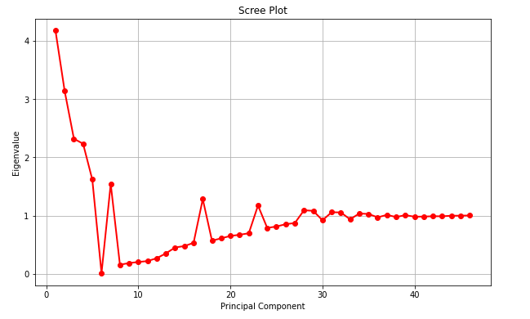
Dimensionality Reduction
Experiment to Test the Impact of Dimensionality Reduction on End Product.
Principal Component Analysis
PCA implementation to check the variables that are highly significant and independent of one another in order to reduce the bias in prediction.
Note: PCA to reduce the complexity of the algorithm
The scree plot above revealed the number of components for the dimensionality reduction is 18. This is shown from the eigenvalues ≥ 1.
Result: the result shows that reducing the dimensions further will not significantly impact the performance of the model.
MSE = 47.87

Slide 10
Conclusion
Next Steps
This experiment can be further extended to impact real- world applications by:
Adapting cancellation policy data, and discounts on price conditioned by total minimum nights to be spent in the data which immediately increases the advantage when setting price.
Further statistical experiment to validate performance of models.
Summary This experiment presents three machine learning algorithms to predict Airbnb data for price setting utilizing Random Forest, Decision Tree, and ExtraTrees regression. Overall, the results show that Random Forest evaluated with the best performance in all metrics such as mean squared error, mean absolute error and root mean squared error. The experiment recommends dynamic price setting, the distribution of price across locations conditioned by best amenities, pets friendliness and few more important variables revealed same.

